Slide 1
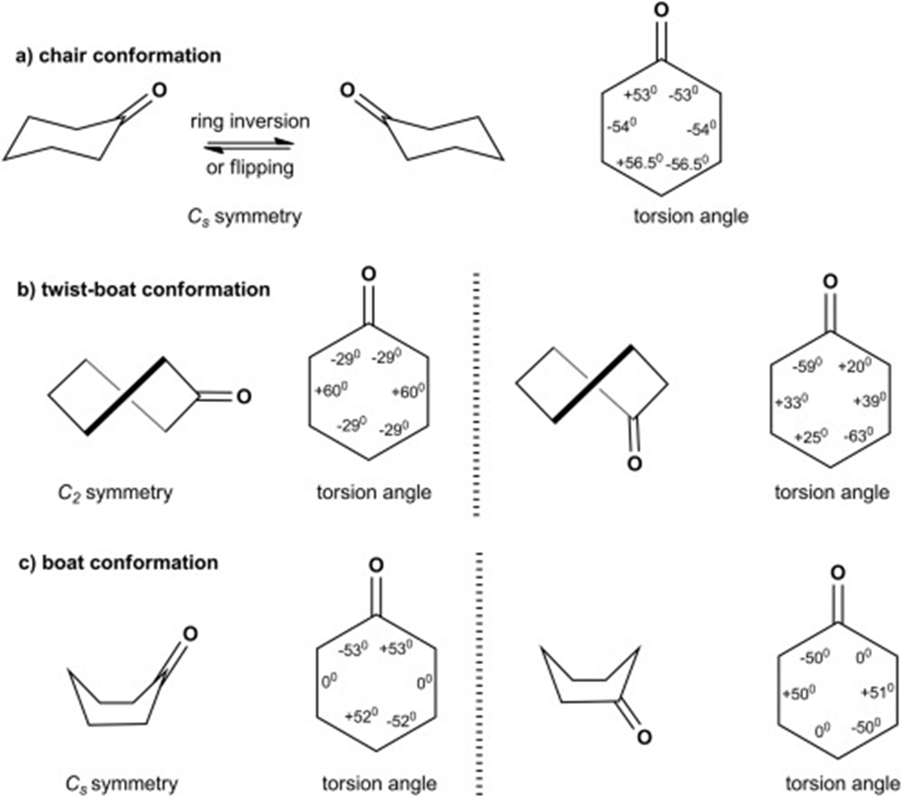

Slide 2
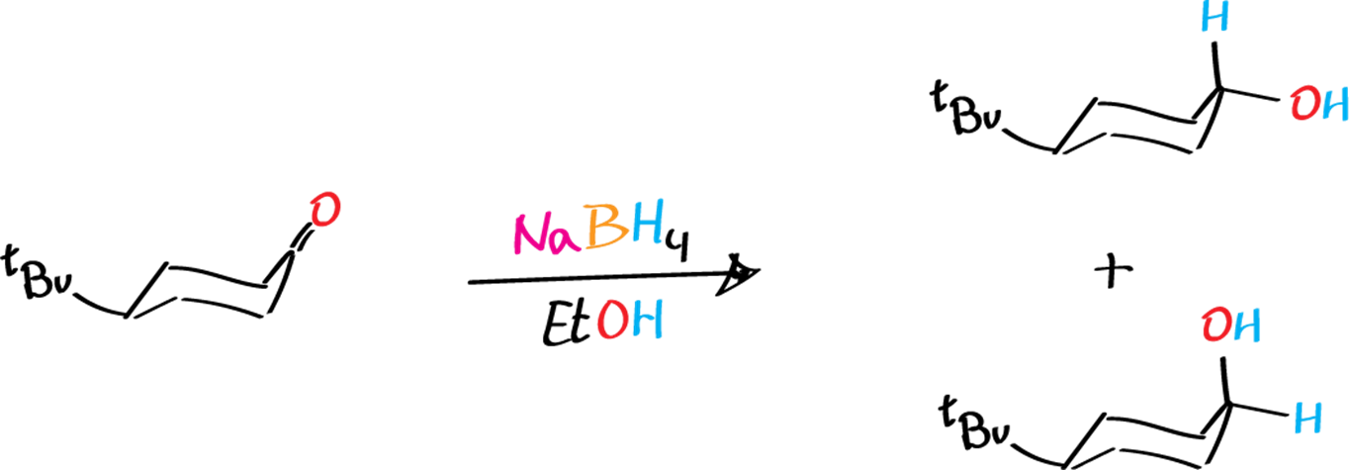
Axial product predominated than equatorial because of less steric hindrance

